Slide 1
Benefits of joining Survivor Alliance:
Become a part of an international, professional, network of survivors of human trafficking and slavery.
Gain access to trainings and workshops on survivor leadership.
Gain access to a free online digital community platform to connect with other survivor leaders. There is an online library of resources you can access.
Contribute to local and global discussions about how to build sustainable and interconnected survivor communities
Develop professional skills that are transferable across employment industries.
Participate actively in anti-trafficking and anti-slavery initiatives.

Slide 2
By joining, what does this mean?

Slide 3
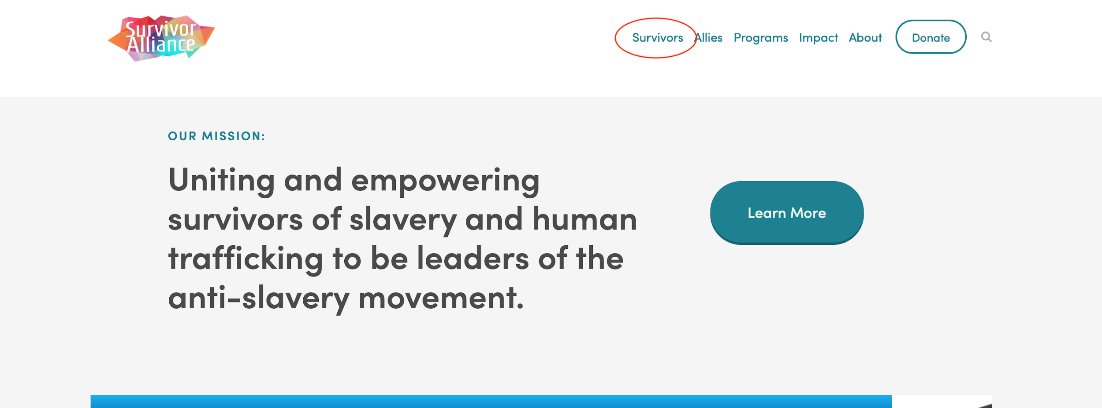
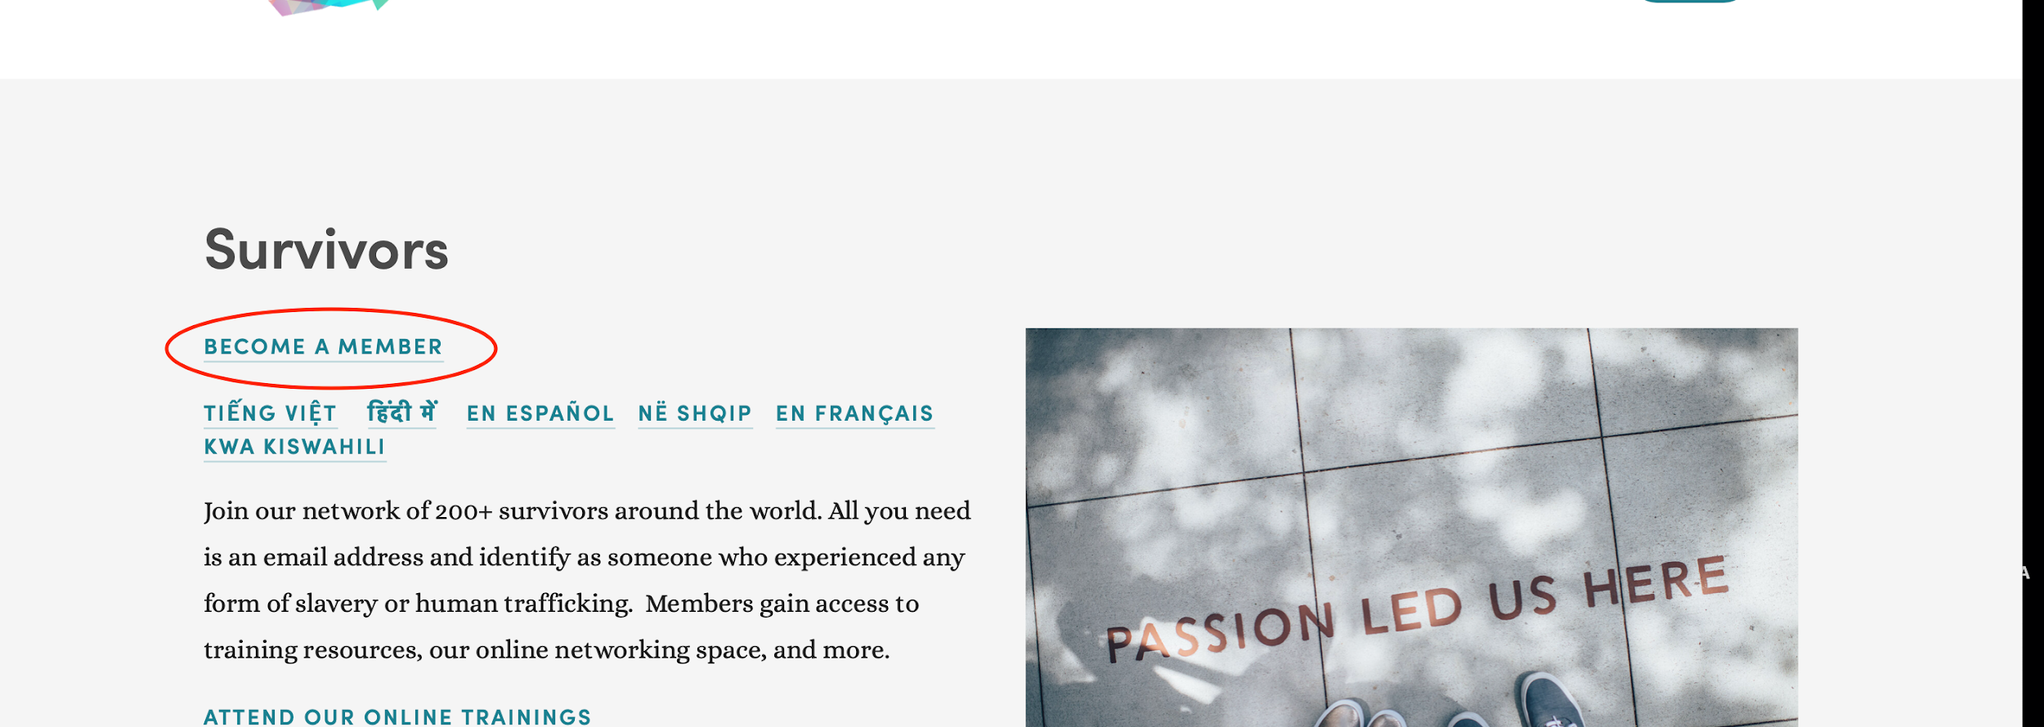
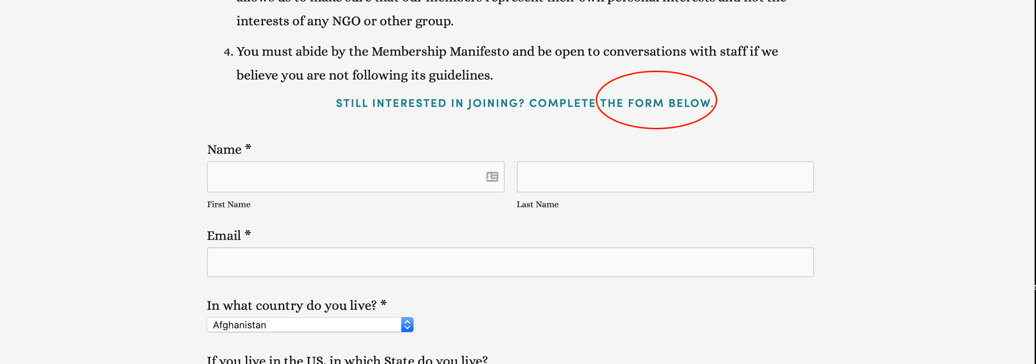
How to join Survivor Alliance:
1. Go to www.survivoralliance.org
2. Click on ‘Survivor”
3. Then click on “Become a member”, you will not immediately signed up!
4.Review our “Manifesto Requirements”. Please - this doesn't sign you up, it just takes you to the ‘Join us’'
5. Fill in our membership form.

Slide 4
How to join Survivor Alliance:

